Slide 1

Remote CARI (rCARI) Validation Study
Results from Iraq pilot
On behalf of :
Alirah WEYORI & Nicole WU (RAM-N)

Slide 2
Background
Traditional food security data is collected as face-to-face for micro/macro level analysis
In recent times face-to-face data collection restricted – limited access
Data gap
Negative impact for program design and implementation
WFP developed a novel methodology-remote CARI (rCARI)
Notes:
rCARI useful in emergencies where F2F survey is not feasible
The Challenge with rCARI numbers & methodology is that not it is been validated against CARI or IPC
Though is easily available, results are not globally accepted

Slide 3
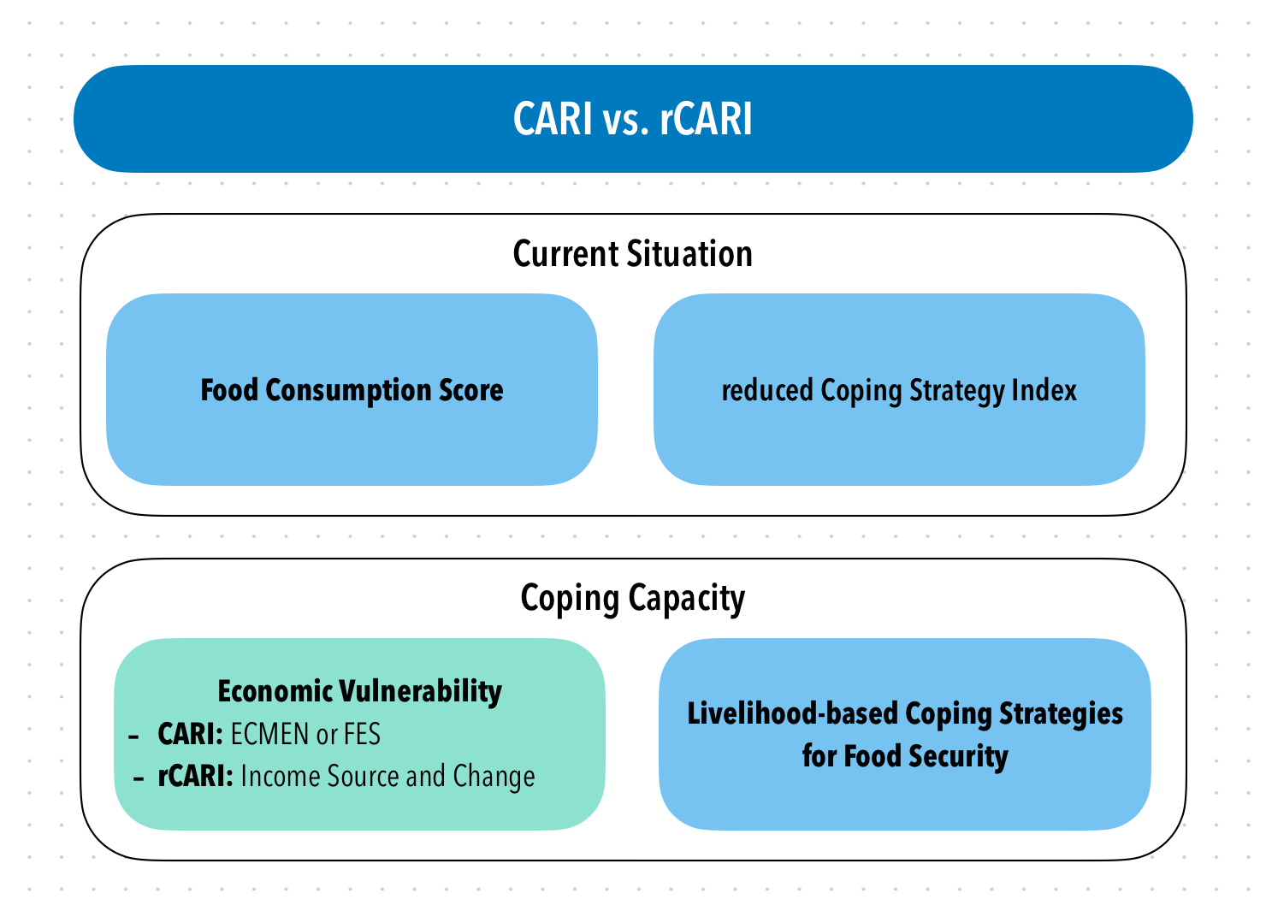
Background
rCARI collects data through phone based or CATI interviews
rCARI aggregates indicators like standard CARI
For the purpose of this study CARI calculated from FES will be compared with rCARI calculated through income sources
ECMEN can never be collected over phone (needs long expenditure module) so CARI with ECMEN is not tested in this study
Notes:
rCARI is based on the following modules
Food consumption score
Consumption-based coping strategy (rCSI)
Livelihood coping strategy (usually a shorter version of the original)
Income sources
Changes in income

Slide 4
Background
There could different possible ways to calculate rCARI: Which method is comparable to CARI
Income sources and change
Short expenditure module to measure food expenditure share (FES)
rCARI is not empirically validated against CARI, at the time of COVID income sources and change in income were used under the assumption that FES and expenditure cannot be collected over phone.
Short expenditure module were not tested against standardized ones
Notes:
Used the available indicators and created rCSI gender-sensitive
Sampled at HH level and interviewed 2 members in each HH (male and female)
We got money from Gender, we had time before the official start of the rCARI study

Slide 5
Research questions
How does the rCARI aggregation using income sources compare with CARI using FES, regardless of the modality?
How does interview modality (f2f vs remote) affect the reporting on different FS indicators included in both aggregate?
Inter-household comparison (Remote-first gp compared with F2F-first qp)
Intra-household comparison FS reporting (same HH over time)
What is the diagnostic accuracy of the different versions' expenditure module?
FES-long v3 FES-short in F2F interview
FES-very short module in phone interview

Slide 6
Iraq Pilot Sample Design
1st Interview
Follow-up interview
Group A (Phone)
375 HH
Group A
(F2F)
300 HH
Max interval 48 Hours
Sampled HH
(600 + 25% attrition)
Group B
(F2F)
375 HH
Group B (Phone)
300 HH
Max intervals 48 Hours

Slide 7
Iraq Pilot Sample Design
1st Interview
Follow-up interview
Group A (Phone)
375 HH
Group A (F2F) 300
Max interval 48 Hours
150 HH Long-modules
Sampled HH
(600 + 25% attrition)
150 HH Short Modules
Group B (F2F) 375
Group B (Phone)
300 HH
188 HH Long-modules
Max intervals 48 Hours
187 HH Short Modules

Slide 8
Implementation
Cross-over design: 2 groups of HH from the same sample
We Sampled 676 households from 2 IDP and 2 refugee camps
Each household was interviewed twice
Face-to-face
Remote
This would allow for intra- and inter-household validation of the measurements

Slide 9
Implementation
Follow-up interview
Same HH
Follow-up interview
Same respondent
1st Interview
Group A (Phone)
307 HH
Group A
(F2F)
221 HH
Group A
(F2F)
68 HH
Max interval 48 Hours
Sampled HH
676
Attrition rate
28%
78%
Group B (Phone)
233 HH
Group B (Phone)
66 HH
Group B
(F2F)
369 HH
Max intervals 48 Hours
Attrition rate
37%
82%

Slide 10
Limitations
Pre-exposure bias from first interview
Short interval between the first and second interview, The indicators reported in the second interview is influenced by the recall from the first interview
If long intervals were applied the reference period for the indicators were have changed and the estimations (difficult to have wash-out period)
The pre exposure bias is not equivalent in the 2 arms of the study (one group is pre-exposed to phone interview and the other pre-exposed to F2F)
Notes:
Used the available indicators and created rCSI gender-sensitive
Sampled at HH level and interviewed 2 members in each HH (male and female)
We got money from Gender, we had time before the official start of the rCARI study

Slide 11
Limitations (Cont.)
Different attrition rates between the two arms of the study
28% for phone first and 37% for F2F first groups
Probably F2F first were more reluctant to pick up the phone as they expect long discussion on the same questions
This resulted in unbalanced sample between the 2 arms (therefor the inter-HH comparison was not feasible)
Notes:
Used the available indicators and created rCSI gender-sensitive
Sampled at HH level and interviewed 2 members in each HH (male and female)
We got money from Gender, we had time before the official start of the rCARI study

Slide 12
Limitations (Cont.)
Respondent bias
Difficulty in getting the exact same respondent within the household to answer the two questionnaires
Several visits (2-3) visits to the same HH to catch the same person
When the HH has only one phone (usually with the man) and the women answers the HH questionnaire (bc man is outside) the phone interview had to happen with the phone owner
If we try to conduct intra-HH comparison the sample will be very small 134 (68 vs 66) and we would have lost a lot of collected data (78% and 82%)
Notes:
Used the available indicators and created rCSI gender-sensitive
Sampled at HH level and interviewed 2 members in each HH (male and female)
We got money from Gender, we had time before the official start of the rCARI study

Slide 13
Final Interviewed HHs
Only F2F
136 HH
Total F2F
590 HH
Total Sample
676 HH
Completed
454 HH
Only Remote
86 HH
Total Remote
540 HH
In total completed interviews
136 HH completed only face-to-face modality
86 HH completed only remote modality

Slide 14
Final Interviewed HHs
F2F 1st
233 HH
Follow-Up
233
Unique HH interviews
676 HH
Completed Both Modalities
454 HH
Remote 1st
221
Follow up
221
F2F Interviews 590
Interview numbers
All households did not complete both modalities
136 F2F “households” were not successfully interviewed for the remote modality
86 Remote “households” were not successfully interviewed for the F2F modality
454 “Households” (not SAME respondents) had completed both modalities within the window of reporting
Rem. Interviews 540

Slide 15
Final Interviewed HHs
Inconsistent RESPONDENT for ‘’Matched Modalities”
In 187 HH, have age difference over 2 years across modalities
In 178 HH, respondents relation to household head is inconsistent (firstly indicated as Head and in follow up changed to not Head)
In 176 HH, the respondent’s sex is different across modalities
Acceptable Crossover sample must exclude all these
134 HH have exact the same respondent responding to both modalities [TRUE crossover sample]

Slide 16
Final Interviewed HHs
F2F 1st
68 HH
Follow-Up
68 HH
True Cross-over sample
134 HH
Completed Both Modalities
134 HH
Remote 1st
66 HH
Follow up
66 HH
F2F Interviews = 68 HH
Interview numbers [TRUE Cross-Over HHs]
This sample had same household member (age, gender and relationship to household head
68 of these respondents started with F2F modality first
66 of these respondents started with remote modality first
Remote Interviews = 66 HH

Slide 17
Final Interviewed HHs

Slide 18
How does the different versions of rCARI compare with CARI v3?

Slide 19
rCARI from remote versus CARI v3 F2F
 | F2F Answer | Remote Answer | Difference | P Value
FCS | 62.22 | 56.00 | 6.22 | 0.00
rCSI | 14.74 | 14.15 | 0.59 | 0.43
Used Stress-Level Coping | 0.89 | 0.89 | -0.00 | 0.82
Used Crisis-Level Coping | 0.69 | 0.62 | 0.08 | 0.01
Used Emergency-Level Coping | 0.08 | 0.28 | -0.19 | 0.00
HHExpFood | 307827.17 | 450377.60 | -142550.43 | 0.00
HHExpNF | 344632.66 | 264484.03 | 80148.63 | 0.00
HHExpTotal | 652459.82 | 714861.63 | -62401.81 | 0.06
PCExpTotal | 126286.60 | 139006.74 | -12720.14 | 0.08
FES | 50.20 | 64.00 | -13.81 | 0.00
Vulnerability (3 & 4) | 0.24 | 0.55 | -0.31 | 0.00

Slide 20
Intra-HH Outcome Comparison F2F Answer vs. Remote Answer

Slide 21
CARI vs. rCARI Intra-HH Outcome Comparison
[True Crossover n = 134]
Variable | F2F | Remote | Difference | P-Value
FCS | 64.88 | 57.89 | 6.99 | 0.00
rCSI | 12.64 | 13.17 | -0.53 | 0.62
Used Stress-Level Coping | 0.87 | 0.86 | 0.01 | 0.70
Used Crisis-Level Coping | 0.61 | 0.48 | 0.13 | 0.02
Used Emergency-Level Coping | 0.06 | 0.23 | -0.17 | 0.00
HHExpFood | 342889.38 | 422654.59 | -79765.21 | 0.00
HHExpNF | 360354.48 | 170590.17 | 189764.30 | 0.00
HHExpTotal | 703243.85 | 593244.76 | 109999.09 | 0.01
PCExpTotal | 134954.91 | 111814.43 | 23140.48 | 0.00
FES | 51.79 | 72.05 | -20.26 | 0.00
Vulnerability (3 & 4) | 0.21 | 0.53 | -0.32 | 0.00

